Slide 1
Uniformly sampling graphs with constrained degrees
Joel Nishimura
MNS Data Science Seminar

Slide 3
Simple Graphs, Multigraphs, Pseudographs

Slide 4
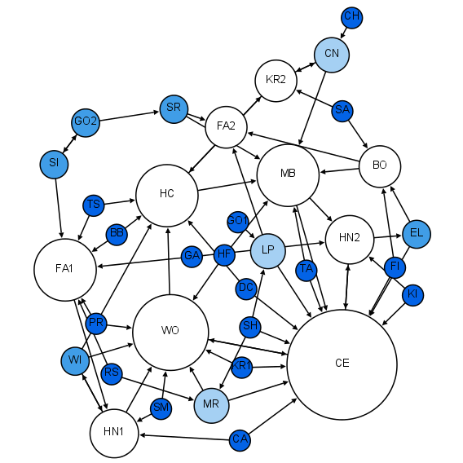
Where do you find graphs?
Jacob Moreno’s sociogram of a 1st Grade Class
By Martin Grandjean - Own work, CC BY-SA 4.0, https://commons.wikimedia.org/w/index.php?curid=39967993

Slide 5
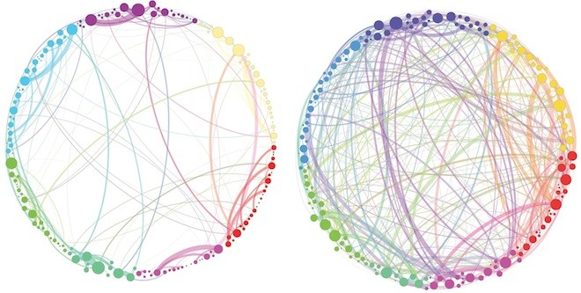
http://www.nextpowerup.com/news/14868/graph-reveals-how-psilocybin-changes-brain-network-communication/

Slide 6
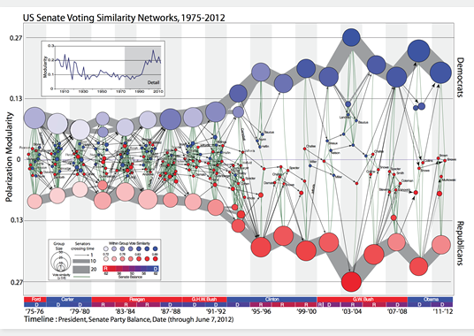

Slide 7
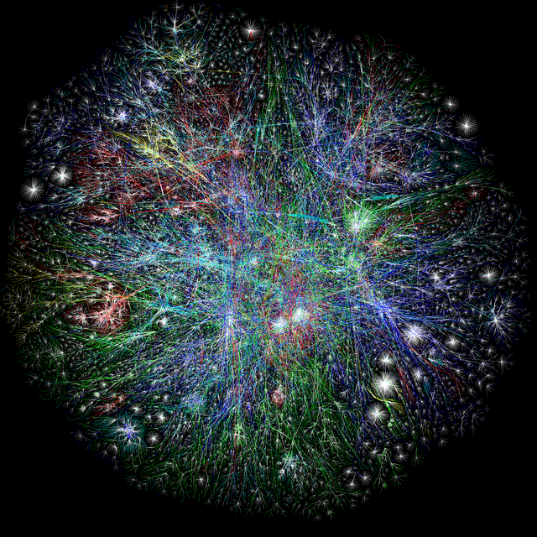

Slide 8
Graph Statistics
Example: Degree Assortativity

Slide 9
Null Models

Slide 10
Degree Constraints

Slide 11
Configuration Model

Slide 12
Stub-Matching Model (Bollobas 1980)

Slide 13
O(1) multi-edges and self-loops

Slide 14
Stub-Matching differs from Vertex Labeling

Slide 19
Sampling, less straight forward
So let’s try MCMC approaches

Slide 20
Double Edge Swaps
Rediscovered many times, first by Petersen in 1891.

Slide 21
Graph of Graphs
One for each space of graphs

Slide 22
MCMC Numerical Worksheet

Slide 23
Conditions for MCMC (Ergodic and Irreducible)
Can also be phrased in terms of properties of the Graph of Graphs.
Separate cases for Stub and Vertex labeling

Slide 24
Simplest Case: Stub-Labeled Pseudographs

Slide 25
Pseudographs: GoG Regular
Count number of pairs of edges

Slide 26
Pseudographs: GoG Aperiodic

Slide 27
Pseudographs: GoG Connected?

Slide 28
Simple Graphs
Regularity and Aperiodicity remain easy.

Slide 29
Simple Graphs: GoG Strongly Connected
Rediscovered in 1962,1973, 1981 (twice in same journal), 1994, 2010 and in 2013.

Slide 30
Multigraphs (no self-loops)
Still connected.

Slide 31
Loopy-Graphs
Graphs with no duplicate edges, but possibly with self-loops

Slide 32
Vertex Labeling

Slide 34
Graph of Loopy-Graphs Not Connected

Slide 38
Graph of Loopy-Graphs Not Connected

Slide 39
Introduce G^{d}

Slide 42
Questions

